Slide 1
Welcome to ACG

Slide 2
Admin matters
Nominate class rep(s) for your class. Be a point of contact for matters regarding ACG.
Form groups for Assignment 1 by start of week 2(up to four members per group)
Please let me know of the group composition by start of week 2 through email, through your class rep.
My email: how_kiam_cheng@ichat.sp.edu.sg

Slide 3
Classical Ciphers Encryption Techniques
Adopted from “Cryptography and Network Security” by
W. Stallings. ISBN: 9781292158587
Notes:
Lecture slides adopted from Lawrie Brown for “Cryptography and Network Security”, 4/e, by William Stallings, Chapter 2 – “Classical Encryption Techniques”.

Slide 4

Content
Cryptology
Cryptography
Cryptanalysis
Steganography
Classical ciphers
Rotor Machines

Slide 5
Terminology
plaintext - original message
ciphertext - coded message
cipher - algorithm for transforming plaintext to ciphertext
key - info used in cipher, known only to sender/receiver
encipher (encrypt) - converting plaintext to ciphertext
decipher (decrypt) - recovering ciphertext from plaintext
cryptography - study of encryption principles/methods
cryptanalysis (codebreaking) - study of principles/ methods of deciphering ciphertext without knowing key
cryptology - field of both cryptography and cryptanalysis

Slide 6
Cryptography
Categorize cryptographic systems by:
Different types of encryption operations used
substitution / transposition / product (multiple stages of substitutions and transpositions)
number of keys used
single-key or secret key / two-key or public key
way in which plaintext is processed
block (blocks of elements) / stream (one elements at a time)
Quiz : Identify the encryption operations in the following slide
Notes:
Substitution, in which each element in the plaintext (bit, letter, group of bits or letters) is mapped into another element
Transposition, in which elements in the plaintext are rearranged. The fundamental requirement is that no information be lost (i.e., that all operations are reversible).
Most systems, referred to as product systems, involve multiple stages of substitutions and transpositions.

Slide 7
Caesar cipher
Plain: meet me after the party
Cipher: PHHW PH DIWHU WKH SDUWB
Replacing each letter of the alphabet with the letter standing three places further down the alphabet.
Encryption operation :
Substitution
Strength of the cipher :
Weak
Notes:
Operation : Substitution
Key : 1 key (right 23)
Way of processing : Block / Stream

Slide 8
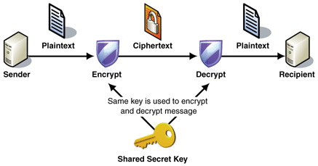
Simplifed Symmetric Cipher
Later chapters will have more details, this is for illustration only
Notes:
Operation – Product Cipher
Key - 1 key
Way of processing = Block

Slide 9
Symmetric Encryption
Also known as single-key encryption
Sender and receiver share a common key
Mathematically:
C = E_{K}(P)
P = D_{K}(C)
All classical encryption algorithms are symmetric key algorithms
Symmetric key encryption is by far the most widely used
plaintext = P,
ciphertext = C,
key = K,
encryption algorithm = E_{K}, decryption algorithm = D_{K}.
Notes:
Symmetric encryption, also referred to as conventional encryption or single-key encryption, was the only type of encryption in use prior to the development of public-key encryption in the 1970s. It remains by far the most widely used of the two types of encryption. All traditional schemes are symmetric / single key / private-key encryption algorithms, with a single key, used for both encryption and decryption. Since both sender and receiver are equivalent, either can encrypt or decrypt messages using that common key.

Slide 10
Requirements
2 requirements for the secure usage of a symmetric encryption:
a strong encryption algorithm
a secret key known only to sender & receiver
Usually the encryption algorithm is publicly known. P = D_{K}(C) is not possible without k
Implies a secure channel is needed to distribute the key
Notes:
We assume that it is impractical to decrypt a message on the basis of the cipher- text plus knowledge of the encryption/decryption algorithm, and do not need to keep the algorithm secret; rather we only need to keep the key secret. This feature of symmetric encryption is what makes it feasible for widespread use. It allows easy distribution of s/w and h/w implementations.
Can take a closer look at the essential elements of a symmetric encryption scheme: mathematically it can be considered a pair of functions with: plaintext X, ciphertext Y, key K, encryption algorithm E_{K}, decryption algorithm D_{K}.

Slide 11
Cryptanalysis
There are two general approaches to attacking a conventional encryption scheme:
General approaches:
brute-force attack
Try all possible keys
cryptanalytic attack
Based on nature of algorithm
General characteristic of plaintext
Sample of plaintext-ciphertext pairs
The objective of attacking an encryption system is to recover the key in use rather than simply to recover the plaintext of a single ciphertext.
Notes:
Show these examples
Brute force example
Goto https://planetcalc.com/1434/ and ENTER the following QEFP FP X QBPQ and press Calculate
Cryptanalytic attack example
Goto http://www.dcode.fr/frequency-analysis and
ENTER the following QEFP FP X QBPQ
Select SUGGEST A MONOALPHABETIC DECRYPTION (STATISTICAL METHOD) option
Press LAUNCH ANALYSIS (see table below on distribution)
Select CALCULATE FREQUENCIES and press Press LAUNCH ANALYSIS
Check Left Panel

Slide 12
Cryptanalytic Attacks Terminology
Unconditional security (Ideal solution)
No matter how much computer power or time is available, the cipher cannot be broken since the ciphertext provides insufficient information to uniquely determine the corresponding plaintext
Computational security (Realistic solution)
given limited computing resources (eg time needed for calculations is greater than age of universe), the cipher cannot be broken
Quiz : what is the age of universe?
Notes:
Stop here for Week 1
Two more definitions are worthy of note.
An encryption scheme is unconditionally secure if the ciphertext generated by the scheme does not contain enough information to determine uniquely the corresponding plaintext, no matter how much ciphertext is available.
An encryption scheme is said to be computationally secure if either the cost of breaking the cipher exceeds the value of the encrypted information, or the time required to break the cipher exceeds the useful lifetime of the information. Unconditional security would be nice, but the only known such cipher is the one-time pad (later).
For all reasonable encryption algorithms, we have to assume computational security where it either takes too long, or is too expensive, to bother breaking the cipher.

Slide 13
Cryptanalytic Attacks
Based on the amount of information known to the cryptanalyst. Cryptanalytic attacks can be classified as:-
ciphertext only
only know algorithm & ciphertext, is statistical, know or can identify plaintext (most difficult!!)
known plaintext
know/suspect plaintext & ciphertext
chosen plaintext
select plaintext and obtain ciphertext
chosen ciphertext
select ciphertext and obtain plaintext
chosen text
select plaintext or ciphertext to en/decrypt
Notes:
Stallings Table 2.1 summarizes the various types of cryptanalytic attacks, based on the amount of information known to the cryptanalyst, from least to most. The most difficult problem is presented when all that is available is the ciphertext only. In some cases, not even the encryption algorithm is known, but in general we can assume that the opponent does know the algorithm used for encryption. Then with increasing information have the other attacks. Generally, an encryption algorithm is designed to withstand a known-plaintext attack.

Slide 14
Brute Force Search
simply try every possible key
most basic attack, proportional to key size
assume either know / recognise plaintext
Key Size (bits) | Number of Alternative Keys | Time required at 1 decryption/µs | Time required at 10⁶ decryptions/µs
32 | 2³² = 4.3 × 10⁹ | 2³¹ µs = 35.8 minutes | 2.15 milliseconds
56 | 2⁵⁶ = 7.2 × 10¹⁶ | 2⁵⁵ µs = 1142 years | 10.01 hours
128 | 2¹²⁸ = 3.4 × 10³⁸ | 2¹²⁷ µs = 5.4 × 10²⁴ years | 5.4 × 10¹⁸ years
168 | 2¹⁶⁸ = 3.7 × 10⁵⁰ | 2¹⁶⁷ µs = 5.9 × 10³⁶ years | 5.9 × 10³⁰ years
26 characters (permutation) | 26! = 4 × 10²⁶ | 2 × 10²⁶ µs = 6.4 × 10¹² years | 6.4 × 10⁶ years
Extra Reading : http://tjscott.net/crypto/64bitcrack.htm
Notes:
A brute-force attack involves trying every possible key until an intelligible translation of the ciphertext into plaintext is obtained. On average, half of all possible keys must be tried to achieve success. Stallings Table 2.2 shows how much time is required to conduct a brute-force attack, for various common key sizes (DES is 56, AES is 128, Triple-DES is 168, plus general mono-alphabetic cipher), where either a single system or a million parallel systems, are used.

Slide 15
One-Time Pad (ideal cipher)
One-Time pad is unbreakable since
ciphertext bears no statistical relationship to the plaintext
for any plaintext & any ciphertext there exists a key mapping one to the other
Practical difficulties in generation & safe distribution of the key that can be used once only. As such, one-time pad is not widely used today
Preconditions for a one-time pad
 The key must be as long as the plain text.
 The key must be truly random.
 The key must only be used once
Notes:
Special Attention Required
The One-Time Pad is an evolution of the Vernham cipher, which was invented by Gilbert Vernham in 1918, and used a long tape of random letters to encrypt the message. An Army Signal Corp officer, Joseph Mauborgne, proposed an improvement using a random key that was truly as long as the message, with no repetitions, which thus totally obscures the original message. It produces random output that bears no statistical relationship to the plaintext. Because the ciphertext contains no information whatsoever about the plaintext, there is simply no way to break the code, since any plaintext can be mapped to any ciphertext given some key.
The one-time pad offers complete security but, in practice, has two fundamental difficulties:
There is the practical problem of making large quantities of random keys.
2. And the problem of key distribution and protection, where for every message to be sent, a key of equal length is needed by both sender and receiver.
Because of these difficulties, the one-time pad is of limited utility, and is useful primarily for low-bandwidth channels requiring very high security.

Slide 16
Steganography
An alternative to encryption
It hides the existence of a message
using only a subset of the letters/words in a longer message marked in some way
using invisible ink
hiding information in LSB in graphic image or sound file
Drawbacks
high overhead to hide relatively few info bits
Binary codes that represent a picture
1000101 | 11000110 | 01011010 | 00111100
Information to hide is 1111
1000101 | 11000111 | 01011011 | 00111101
LSB of each byte is replaced by 1111
Notes:
Steganography is an alternative to encryption which hides the very existence of a message by some means. There are a large range of techniques for doing this.
Steganography has a number of drawbacks when compared to encryption. It requires a lot of overhead to hide a relatively few bits of information.
Also, once the system is discovered, it becomes virtually worthless, although a message can be first encrypted and then hidden using steganography.
Exercise
Goto Bb → ACG -> Learning Resources -> Lectures -> Encryption Techniques in classical cipher -> Nothing-to-hide.png
ASK student to visit this site : https://manytools.org/hacker-tools/steganography-encode-text-into-image/

Slide 17
Classical ciphers
Substitution ciphers
Transposition ciphers
These ciphers were proven to be good years ago

Slide 18
Substitution Ciphers
Letters of the plaintext are replaced by other letters, numbers or symbols
or if a plaintext is viewed as a sequence of bits, then the substitution involves replacing plaintext bit patterns with ciphertext bit patterns

Slide 19
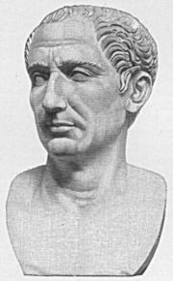
Caesar Cipher
Caesar cipher – revisit
the earliest known substitution cipher
by Julius Caesar
first use in military affairs
How it works
replace each letter by 3rd letter on
meet me after the toga party
PHHW PH DIWHU WKH WRJD SDUWB
Notes:
Exercise
Goto Bb → ACG -> Learning Resources -> Lectures -> Encryption Techniques in classical cipher -> Decode Me.txt
USE https://planetcalc.com/1434/

Slide 20
Caesar Cipher
We can define the transformation as:
a b c d e f g h i j k l m n o p q r s t u v w x y z
D E F G H I J K L M N O P Q R S T U V W X Y Z A B C
If we mathematically number the letters
a b c d e f g h i j k l m n o p q r s t u v w x y z
0 1 2 3 4 5 6 7 8 9 10 11 12 13 14 15 16 17 18 19 20 21 22 23 24 25
then Caesar cipher will be represented as:
c = E_{k}(p) = (p + k) mod (26)
p = D_{k}(c) = (c – k) mod (26)
Notes:
This mathematical description uses modulo (clock) arithmetic. Here, when you reach Z you go back to A and start again. Mod 26 implies that when you reach 26, you use 0 instead (ie the letter after Z, or 25 + 1 goes to A or 0).
Example: howdy (7,14,22,3,24) encrypted using key f (ie a shift of 5) is MTBID

Slide 21
Monoalphabetic Cipher
Rather than just shifting the alphabets
We could arbitrarily map each plaintext letter to a different random ciphertext letter
The key is 26 letters long. n! > 4 * 10²⁶
Plain: abcdefghijklmnopqrstuvwxyz
Cipher: DKVQFIBJWPESCXHTMYAUOLRGZN
Plaintext: ifwewishtoreplaceletters
Ciphertext: WIRFRWAJUHYFTSDVFSFUUFYA
Key
can be any permutation of the 26 alphabetic characters!!
Notes:
With only 25 possible keys, the Caesar cipher is far from secure.
A dramatic increase in the key space can be achieved by allowing an arbitrary substitution, where the translation alphabet can be any permutation of the 26 alphabetic characters.
See example translation alphabet, and an encrypted message using it.

Slide 22
Playfair Cipher
Not even the large number of keys in a monoalphabetic cipher provides security
If the cryptanalyst knows the nature of the plaintext (e.g., non-compressed English text), then the analyst can exploit the regularities of the language. i.e The number of time (frequency distribution) a particular letter say “Z” appears in the ciphertext
One approach to improving security was to encrypt multiple letters
Playfair Cipher is such an example
Playfair cipher was invented by Charles Wheatstone in 1854, but named after his friend Baron Playfair
Notes:
Special Attention Required
Consider ways to reduce the "spikyness" of natural language text, since if just map one letter always to another, the frequency distribution is just shuffled. One approach is to encrypt more than one letter at once. The Playfair cipher is an example of doing this.

Slide 23
Playfair Key Matrix
A 5 x 5 matrix of letters based on the key
Fill in the key, remove any duplicate letters (use I and J interchangeably)
Fill up the matrix with the remaining letters
eg. using the key MONARCHY
M | O | N | A | R
C | H | Y | B | D
E | F | G | I/J | K
L | P | Q | S | T
U | V | W | X | Z
Notes:
Special Attention Required
Try the cipher online http://www.cryptool-online.org/index.php?option=com_cto&view=tool&Itemid=85&lang=en
The best-known multiple-letter encryption cipher is the Playfair, which treats digrams in the plaintext as single units and translates these units into ciphertext digrams. The Playfair algorithm is based on the use of a 5x5 matrix of letters constructed using a keyword. The rules for filling in this 5x5 matrix are: L to R, top to bottom, first with keyword after duplicate letters have been removed, and then with the remain letters, with I/J used as a single letter. This example comes from Dorothy Sayer's book "Have His Carcase", in which Lord Peter Wimsey solves it, and describes the use of a probably word attack.

Slide 24
Encrypting and Decrypting
Plaintext is encrypted 2 letters at a time
1. if a pair is a repeated letter, insert filler like 'X’
i.e hello → he lx lo
2. if both letters fall in the same row, replace each with letter to right (wrapping back to start from end)
i.e “AR” → “RM”
3. if both letters fall in the same column, replace each with the letter below it (again wrapping to top from bottom)
i.e “MU” → “CM”
4. otherwise each letter is replaced by the letter in the same row and in the column of the other letter of the pair
i.e “HS” → “BP” and “EA” → “IM” or “JM”
M | O | N | A | R
C | H | Y | B | D
E | F | G | I/J | K
L | P | Q | S | T
U | V | W | X | Z
Check this example out in youtube:-
https://www.youtube.com/watch?v=52QCEiMqtJE
Decrypting : The reverse of the Encrypting scheme.
Notes:
Special Attention Required
Plaintext is encrypted two letters at a time,according to the rules as shown. Note how you wrap from right side back to left, or from bottom back to top.
if a pair is a repeated letter, insert a filler like 'X', eg. "balloon" encrypts as "ba lx lo on"
if both letters fall in the same row, replace each with letter to right (wrapping back to start from end), eg. “ar" encrypts as "RM"
if both letters fall in the same column, replace each with the letter below it (again wrapping to top from bottom), eg. “mu" encrypts to "CM"
otherwise each letter is replaced by the one in its row in the column of the other letter of the pair, eg. “hs" encrypts to "BP", and “ea" to "IM" or "JM" (as desired)
Decrypting of course works exactly in reverse. Can see this by working the example pairs shown, backwards.

Slide 25
Security of Playfair Cipher
Security is much improved over monoalphabetic
There are 26 x 26 = 676 digraphs
Need to analyse a frequency table of 676 entries (verses 26 for a monoalphabetic encryption)
thus it needs more ciphertexts to analyse
Playfair cipher was widely used for many years
eg. by US & British military in WWI and WWII
It can be broken, given a few hundred letters, since it still has much of the plaintext structure
Notes:
The Playfair cipher is a great advance over simple monoalphabetic ciphers, since there are 26*26=676 digrams (vs 26 letters), so that identification of individual digrams is more difficult. Also,the relative frequencies of individual letters exhibit a much greater range than that of digrams, making frequency analysis much more difficult. The Playfair cipher was for a long time considered unbreakable. It was used as the standard field system by the British Army in World War I and still enjoyed considerable use by the U.S.Army and other Allied forces during World War II. Despite this level of confidence in its security,the Playfair cipher is relatively easy to break because it still leaves much of the structure of the plaintext language intact

Slide 26
Polyalphabetic Ciphers
The same plaintext letters can be replaced by different ciphertext alphabets
i.e BEE → FHG, depending on key used.
It makes cryptanalysis harder with more alphabets to guess and flatter frequency distribution.
i.e instead of BEE → FHH we have BEE → FHG
A key selects which ciphertext alphabet is used to substitute each letter of the message
Apply each key alphabet in turn, repeat from the start after end of the key is reached.
If key is short and we have a large message to encrypt… still will run into frequency analysis
https://www.youtube.com/watch?v=FoUxUY8w3eU
Notes:
One approach to reducing the "spikyness" of natural language text is used the Playfair cipher which encrypts more than one letter at once. We now consider the other alternative, using multiple cipher alphabets in turn. This gives the attacker more work, since many alphabets need to be guessed, and because the frequency distribution is more complex, since the same plaintext letter could be replaced by several ciphertext letters, depending on which alphabet is used. The general name for this approach is a polyalphabetic substitution cipher. All these techniques have the following features in common:
A set of related monoalphabetic substitution rules is used.
2. A key determines which particular rule is chosen for a given transformation.

Slide 27
Vigenère Cipher
Simplest polyalphabetic substitution cipher
Align the plaintext and key, repeat the key letters to match the plaintext length.
eg using keyword deceptive
key: deceptivedeceptivedeceptive
plaintext: wearediscoveredsaveyourself
Notes:
Special Attention Required
Pronounce : V + En gineer (without En sound)
Discuss this simple example from text Stallings section 2.2.

Slide 28
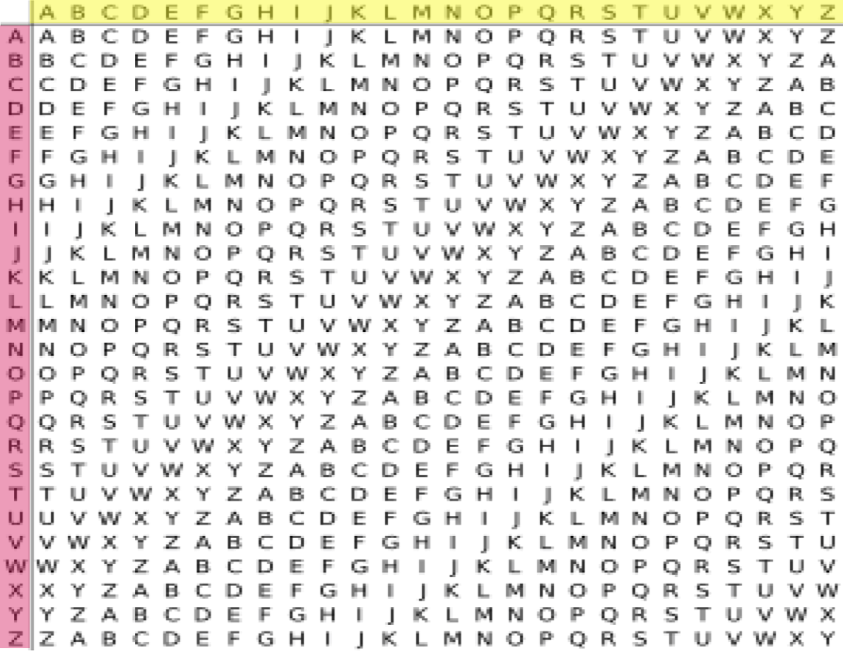
Plaintext
Key Letters
Encrypt the corresponding plaintext letter
key: deceptivedeceptivedeceptive
plaintext: wearediscoveredsaveyourself
ciphertext: ZICVTWQNGRZGVTWAVZHCQYGLMGJ
Notes:
key: deceptivedeceptivedeceptive
plaintext: wearediscoveredsaveyourself
ciphertext:ZICVTWQNGRZGVTWAVZHCQYGLMGJ

Slide 29
Security of Vigenère Cipher
It improves the security having multiple ciphertext letters for each plaintext letter
Letter frequencies are obscured but not totally lost
Start with letter frequency analysis, check whether it matches the monoalphabetic cipher characteristics.
i.e percentage of “e” occurrence
If not, if two identical sequences of plaintext letters occur at a distance that is an integer multiple of the keyword length, they will generate identical ciphertext sequences.
i.e red → VTW. In this case, by guessing, key word length could be either 3 or 9.
Notes:
The Vigenère & related polyalphabetic ciphers still do not completely obscure the underlying language characteristics.
The key to breaking them was to identify the number of translation alphabets, and then attack each separately.
Keyword length is factor of distance

Slide 30
Transposition Ciphers
Transposition or permutation ciphers
hide the message by rearranging the letter order
without altering the actual letters used
can be recognised since they have the same frequency distribution as the original text
Notes:
All the techniques examined so far involve the substitution of a ciphertext symbol for a plaintext symbol. A very different kind of mapping is achieved by performing some sort of permutation on the plaintext letters. This technique is referred to as a transposition cipher, and form the second basic building block of ciphers. The core idea is to rearrange the order of basic units (letters/bytes/bits) without altering their actual values.

Slide 31
Rail Fence cipher
write message letters out diagonally over a number of rows
then read off the ciphertext row by row
eg. write message out as:
m e m a t r h t g p r y
e t e f e t e o a a t
giving ciphertext
MEMATRHTGPRYETEFETEOAAT
Notes:
Special Attention Required
The simplest such cipher is the rail fence technique, in which the plaintext is written down as a sequence of diagonals and then read off as a sequence of rows.
The example message is: "meet me after the toga party" with a rail fence of depth 2.
This sort of thing would be trivial to cryptanalyze.

Slide 32
Row Transposition Ciphers
write letters of the message out in rows over a specified number of columns
then reorder the columns according to some key before reading off the rows
Key: 4 3 1 2 5 6 7
Plaintext: a t t a c k p
o s t p o n e
d u n t i l t
w o a m x y z
Ciphertext:
TTNA APTM TSUO AODW COIX KNLY PETZ
Notes:
A more complex transposition cipher is to write the message in a rectangle, row by row, and read the message off shuffling the order of the columns in each row.
A pure transposition cipher is easily recognized because it has the same letter frequencies as the original plaintext. For the type of columnar transposition just shown, cryptanalysis is fairly straightforward and involves laying out the ciphertext in a matrix and playing around with column positions. Digram and trigram frequency tables can be useful.

Slide 33
Rotor Machines
before modern ciphers, rotor machines were most common complex ciphers in use
widely used in WW2
ie. German Enigma
implemented a very complex, varying substitution cipher
used a series of cylinders, each giving one substitution, which rotated and changed after each letter was encrypted
with 3 cylinders have 26³=17576 alphabets
https://www.youtube.com/watch?v=G2_Q9FoD-oQ
Notes:
Pronounce : E-nig-ma (for German Enigma)
Show Video
https://www.youtube.com/watch?v=G2_Q9FoD-oQ
The next major advance in ciphers required use of mechanical cipher machines which enabled to use of complex varying substitutions.
A rotor machine consists of a set of independently rotating cylinders through which electrical pulses can flow. Each cylinder has 26 input pins and 26 output pins, with internal wiring that connects each input pin to a unique output pin. If we associate each input and output pin with a letter of the alphabet, then a single cylinder defines a monoalphabetic substitution. After each input key is depressed, the cylinder rotates one position, so that the internal connections are shifted accordingly. The power of the rotor machine is in the use of multiple cylinders, in which the output pins of one cylinder are connected to the input pins of the next, and with the cylinders rotating like an “odometer”, leading to a very large number of substitution alphabets being used, eg with 3 cylinders have 26³=17576 alphabets used.
They were extensively used in world war 2, and the history of their use and analysis is one of the great stories from WW2.

Slide 34
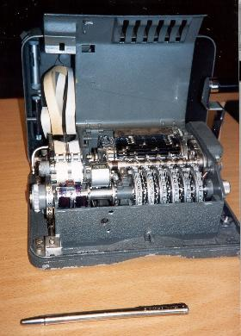
Hagelin Rotor Machine
Notes:
This photo of an Allied Hagelin machine was taken by Lawrie Brown at Eurocrypt'93 in Norway. Note pen for scale, and the rotating cipher wheels near the front.

Slide 35
Product Ciphers
Ciphers using only substitutions or transpositions are not secure because of language characteristics
Since
2 substitutions ➔ more complex substitution
2 transpositions ➔ more complex transposition
Substitution followed by a transposition ➔ new much harder cipher (basis of modern cipher)
Notes:
Have seen that ciphers based on just substitutions or transpositions are not secure, and can be attacked because they do not sufficiently obscure the underlying language structure
So consider using several ciphers in succession to make harder.
A substitution followed by a transposition is known as a Product Cipher, and makes a new much more secure cipher, and forms the bridge to modern ciphers.

Slide 36
Summary
Terminology
cryptanalysis using letter frequencies
Brute force
One Time Pad
stenography
classical cipher techniques
substitution ciphers
transposition ciphers
product ciphers and rotor machines

